Slide 1
mongoose
Dr. Jose Annunziato

Slide 2
mongoose
Mongoose is a MongoDB object modeling tool designed to work in an asynchronous environment
Mongoose provides a straight-forward, schema-based solution to model your application data
It includes built-in type casting, validation, query building, business logic hooks and more, out of the box

Slide 3
Create a Node.js Project
Create a Node.js project using npm
Open project with WebStorm or your favorite editor
$ mkdir whiteboard
$ cd whiteboard
$ npm init
$ git init
$ npm install mongoose --save

Slide 4
Connect to MongoDB Programmatically
In data/db.js, connect to the database
module.exports = function () {
const mongoose = require('mongoose');
const databaseName = 'whiteboard';
var connectionString =
'mongodb://localhost/';
connectionString += databaseName;
mongoose.connect(connectionString);
};

Slide 5
Mongoose schemas
In models/user.schema.server.js
const mongoose = require('mongoose');
const userSchema = mongoose.Schema({
username: String,
password: String,
firstName: String,
lastName: String
}, {collection: 'user'});
module.exports = userSchema;

Slide 6
Mongoose models
In data/models/user.dao.server.js
const mongoose = require('mongoose');
const userSchema = require
('./user.schema.server');
const userModel = mongoose.model
('UserModel', userSchema);
module.exports = userModel;

Slide 7
Use Mongoose models to query database
In data/test.js
require('./db')();
var userDao = require
('./models/user.dao.server');
userDao.find((err, users) => {
console.log(users);
});

Slide 8
Verify Users Retrieved from Database
[ { _id: 5aa5ab73ab319d0f94089fc7,
username: 'ada', firstName: 'Ada',
lastName: 'Lovelace', type: 'FACULTY' },
{ _id: 5aa5b136ab319d0f94089fc9,
username: 'tlee', firstName: 'Tim',
lastName: 'Berners-Lee',type: 'FACULTY' },
{ _id: 5aa95148d982cb8e72af70cd,
username: 'jane', type: 'STUDENT',
gpa: 3.9 },
{ _id: 5aa9515ad982cb8e72af70ce,
username: 'john', gpa: 3.8,
type: 'STUDENT' } ]

Slide 9
MONGOOSE
DAOS
Dr. Jose Annunziato

Slide 10
Encapsulate data access in DAOs
In data/models/user.dao.server.js
const mongoose = require('mongoose');
const userSchema = ...
const userModel = ...
findAllUsers = () =>
userModel.find();
module.exports = { findAllUsers }

Slide 11
Testing findAllUsers()
In data/test.js
require('./db')();
var userDao = ...
userDao.findAllUsers()
.then(users =>
console.log(users));

Slide 12
Find User By Primary Key...
In data/models/user.dao.server.js
...
findUserById = userId =>
userModel.find({_id: userId})
...
module.exports = {
findAllUsers, findUserById
}

Slide 13
Testing findUserById()
In data/test.js
userDao
.findUserById(
'5aa5ab73ab319d0f94089fc7')
.then( user => console.log(user));
[ { _id: 5aa5ab73ab319d0f94089fc7,
username: 'ada', firstName: 'Ada',
lastName: 'Lovelace', type: 'FACULTY'}
]

Slide 14
Use findById() Syntactic Sugar
In data/models/user.dao.server.js
findUserById = userId =>
userModel.find({_id: userId})
userModel.findById(userId)
{ _id: 5aa5ab73ab319d0f94089fc7,
username: 'ada', firstName: 'Ada',
lastName: 'Lovelace', type: 'FACULTY' }

Slide 15
Find By Unique Non Key...
In data/models/user.dao.server.js
findUserByUsername = username =>
userModel
.find({username: username})
module.exports =
{ findUserByUsername...}

Slide 16
Testing findUserByUsername()
In data/test.js
userDao
.findUserByUsername('ada')
.then( user =>
console.log(user));
[ { _id: 5aa5ab73ab319d0f94089fc7,
username: 'ada', firstName: 'Ada',
lastName: 'Lovelace', type: 'FACULTY' } ]

Slide 17
Use findOne() Syntactic Sugar
In data/models/user.dao.server.js
findUserByUsername = username =>
userModel
.find({username: username})
userModel
.findOne({username: username})
{ _id: 5aa5ab73ab319d0f94089fc7,
username: 'ada', firstName: 'Ada',
lastName: 'Lovelace', type: 'FACULTY' }

Slide 18
INSERT, UPDATE, DELETE, MONGOOSE MODELS
Dr. Jose Annunziato

Slide 19
Inserting Objects...
In data/models/user.dao.server.js
createUser user =>
userModel.create(user)
module.exports = {createUser...}
{ _id: 5aa9888dae4e5f3818f0b962,
username: 'paul', password: 'muad\'dib',
firstName: 'Paul', lastName: 'Atreides',
__v: 0 }

Slide 20
Inserting Objects...
In data/test.js
userDao
.createUser({
username: 'paul',
password: 'muad\'dib',
firstName: 'Paul',
lastName: 'Atreides'
}).then(newUser =>
console.log(newUser));

Slide 21
Updating Objects...
In data/models/user.dao.server.js
updateUser = (uid, user) =>
userModel
.update({_id: uid},
{$set: user})
module.exports =
{updateUser...}

Slide 22
Updating Objects...
In data/test.js
userDao
.updateUser(
'5aa9888dae4e5f3818f0b962',
{firstName: 'Paul Muad\'dib'})
.then(status => {
console.log(status);
});
{ n: 1, nModified: 1, ok: 1 }

Slide 23
Deleting Objects...
In data/models/user.dao.server.js
deleteUser = userId =>
userModel
.remove({_id: userId})
module.exports =
{deleteUser...}

Slide 24
Deleting Objects...
In data/test.js
userDao
.deleteUser(
'5aa9888dae4e5f3818f0b962')
.then(status => {
console.log(status);
});
{ n: 1, ok: 1 }

Slide 25
MONGOOSE MANY TO MANY
Dr. Jose Annunziato

Slide 26
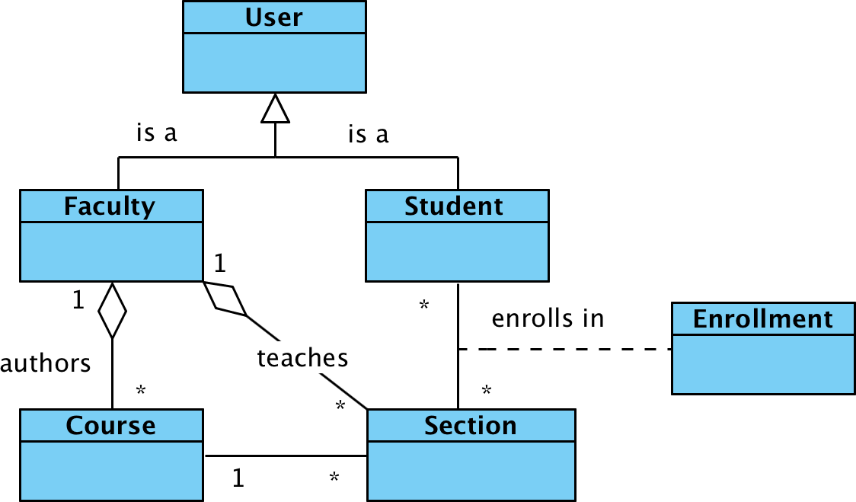
Consider the Following Model

Slide 27
Create Section Schema
data/models/section.schema.server.js
const mongoose = require('mongoose');
const sectionSchema =
mongoose.Schema({
name: String
}, {collection: 'section'});
module.exports = sectionSchema;

Slide 28
Create Section Model
data/models/section.dao.server.js
const mongoose = require('mongoose');
const sectionSchema =
require('./section.schema.server');
const sectionModel =
mongoose.model('SectionModel',
sectionSchema);
module.exports = {};

Slide 29
Implement createSection()
data/models/section.dao.server.js
createSection = section =>
sectionModel.
create(section)
module.exports =
{createSection};

Slide 30
Create a Couple of Sections
data/models/test.js
const sectionDao = require(
'./models/section.dao.server');
sectionDao.createSection(
{name: 'section101'}
);
sectionDao.createSection(
{name: 'section202'}
);

Slide 31
Create Enrollment Schema
data/models/enrollment.schema.server.js
const mongoose = require('mongoose');
const enrollmentSchema = mongoose.Schema({
student: {ref: 'UserModel',
type: mongoose.Schema.Types.ObjectId},
section: {ref: 'SectionModel',
type: mongoose.Schema.Types.ObjectId}
});
module.exports = enrollmentSchema;

Slide 32
References
http://www.mongodb.org
https://mongolab.com
http://mongoosejs.com

